Slide 1

Customer Segmentation Using Clustering (Python)
Aman Jawalekar

Slide 2
Problem Statement
Use K-Means clustering to segment customers based on behavioral and demographic data to enable
targeted marketing strategies.

Slide 3
Data Collection
Data originates from Kaggle’s “Customer Segmentation & Personas” repository. It likely compiles real customer attributes tied to jewelry purchases—demographics, behavior, purchase frequency, average spend, that kind of thing. Even though Kaggle doesn’t always detail acquisition methods, it’s safe to infer the dataset comes from retail systems or surveys aggregated for segmentation.The dataset gives us electronics sales data at Amazon. It contains user ratings for various electronics items sold, along with category of each item and time of sell.
Purpose of CollectionAimed at dissecting jewelry clientele into meaningful clusters. This supports tailored marketing: crafting messaging for “Value-Conscious Occasional Buyers” versus “Affluent Frequent Shoppers.”
Dataset – https://www.kaggle.com/datasets/weihutchinson/customer-segementation-and-personas?select=Jewellery+Customer+Segmentation+Analysis+Personas.csv

Slide 4
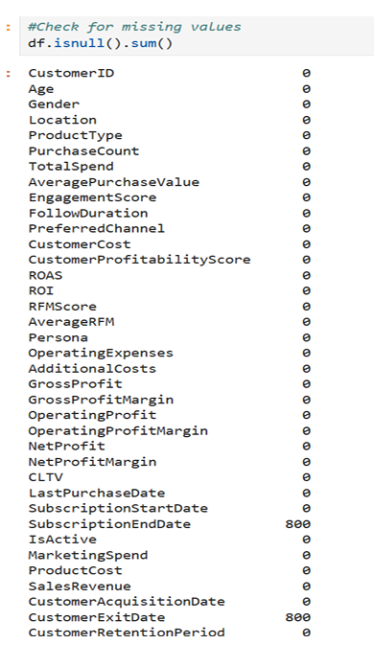
Data Pre-Processing
To ensure clean and reliable data for clustering:
Dropped Irrelevant Columns:
CustomerID (unique identifier, not useful for analysis)
CustomerAcquisitionDate and CustomerExitDate (date fields not required for segmentation).
Removed Missing Records: Rows with missing values were dropped using dropna() to maintain dataset integrity.
Reset Index: After removing rows and columns, the index was reset to maintain sequential order.
These steps prepared the dataset for further preprocessing like encoding and scaling.

Slide 5
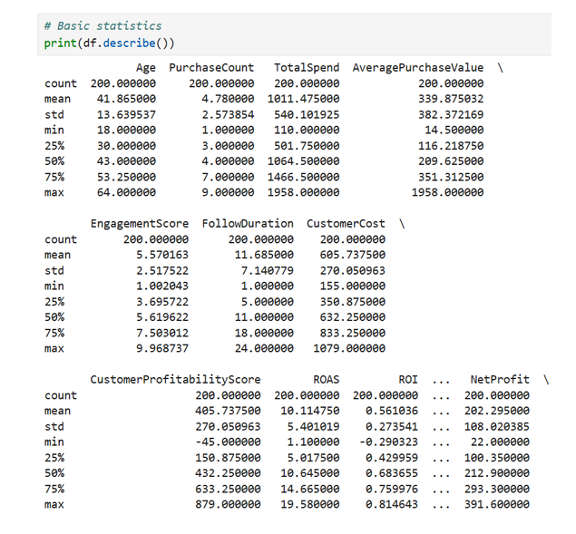
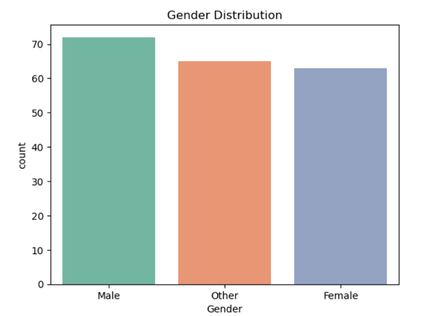
Exploratory Data Analysis

Slide 6
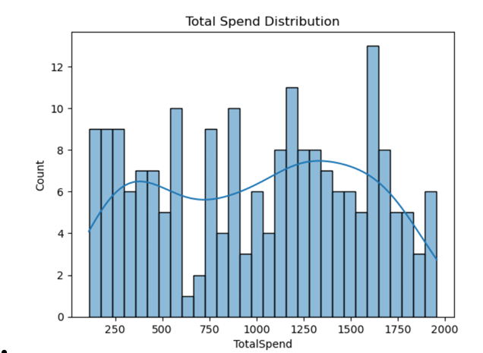
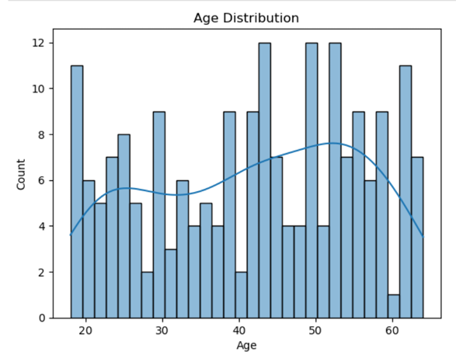

Slide 7
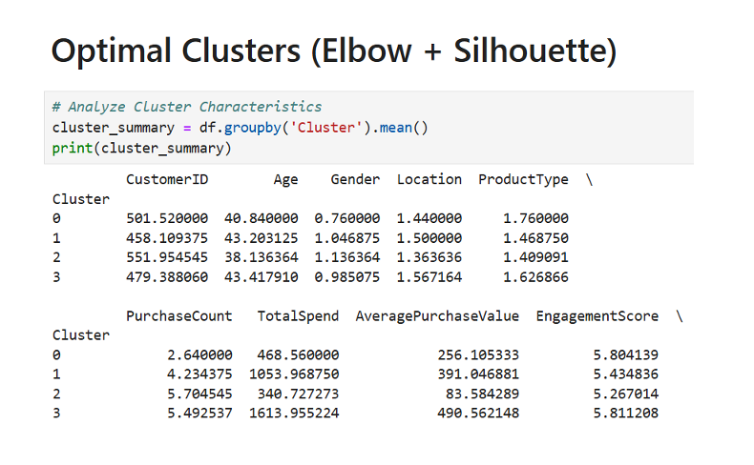
Model

Slide 8
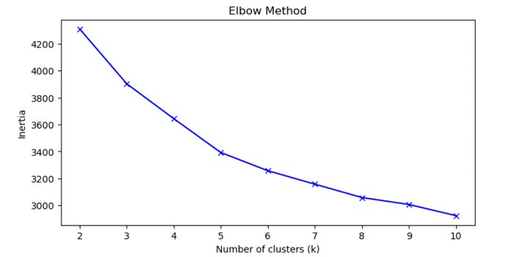
Elbow Method
The elbow point helps balance compactness within clusters and prevents overfitting by limiting unnecessary clusters.

Slide 9
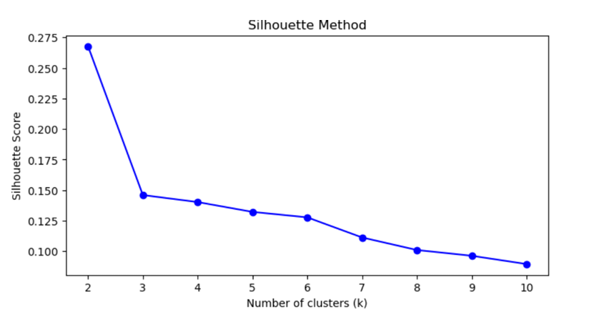
Silhouette Method
This analysis guides how many clusters to use for customer segmentation, balancing tight grouping within clusters and distinct separation between them.

Slide 10
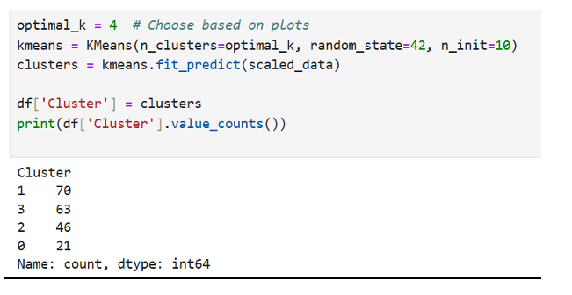
K-Means
The K-Means algorithm is applied to the scaled data, dividing it into four clusters for effective segmentation.
Cluster assignments for each sample are saved in the 'Cluster' column of the DataFrame.
The final output displays the number of records in each cluster, revealing the distribution among customer segments (e.g., 70, 63, 46, and 21 samples in the four clusters).

Slide 11
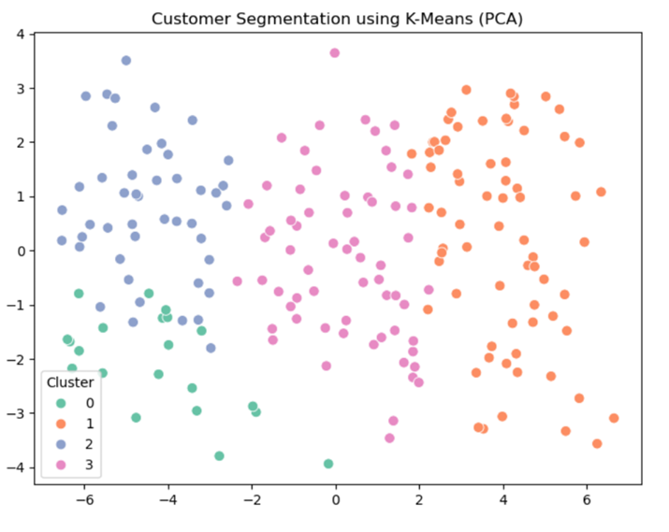
Visualize Clusters using PCA

Slide 12
Conclusion
Spending Distribution: Most customers spend between 500–1500 units; few are high spenders.Correlation Insights:PurchaseCount ↔ TotalSpend = strong positive correlation.
Profitability metrics (ROI, ROAS, etc.) highly correlated.Age shows negligible impact on spend.Engagement: Weak link between engagement score and spending.
RFM: Strong correlation with revenue; useful for segmentation.Customer Segments Identified: High-Value Loyalists, Bargain Seekers, Low-Spend Infrequent Buyers.

Slide 13
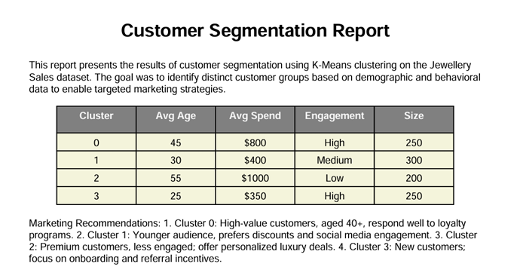
Result
Recommend marketing strategies for each group.
Cluster 0: High-Value Loyal CustomersTraits: 40+, high spend ($800+), loyal, highly engaged.
Strategies: VIP rewards, exclusive events, personalized suggestions, premium after-sales.
Cluster 1: Young, Trend-Driven ShoppersTraits: 20– 35, moderate spend ($300–$500), social media active, price-sensitive.
Strategies: Influencer campaigns, flash sales, referral programs, gamified engagement.
Cluster 2: Premium but Low EngagementTraits: 50+, luxury buyers, low engagement, short follow duration.
Strategies: Concierge service, luxury packaging, personalized emails, direct outreach.
Cluster 3: New or Low-Spend CustomersTraits: 18–25, low spend, short retention, budget-focused.
Strategies: Welcome discounts, affordable bundles, style content marketing, mobile engagement.

Slide 14
Thank You

